Slide 1
Handwritten Prescription Recognition

Slide 2


Supervising Staff
Prof: Mohamed Roshdy
Dr: Ahmed Salah
AI: Ghada Hamed
Notes:
تعرف بالـ staff المشرف علي المشروع

Slide 3


Team Members
Youssif Sherif Eid
Aya Abdelbasset
Donia Adel
Ranya Roshdy Hassan
Abdelrahman Ibrahim
Notes:
تعرف اعضاء الـ team

Slide 4











Agenda
Problem definition & Motivation
Objective
System Architecture
Phases Description
Datasets
Experimental Results
Problem Faced
Conclusion
Demo
Future Work
Tools
Notes:
دي الـ agenda الي هنتكلم عنها في الـ seminar

Slide 5

Agenda
Problem definition & Motivation
Objective
System Architecture
Phases Description
Datasets
Experimental Results
Problem Faced
Conclusion
Demo
Future Work
Tools
Notes:
دي الـ agenda الي هنتكلم عنها في الـ seminar

Slide 6
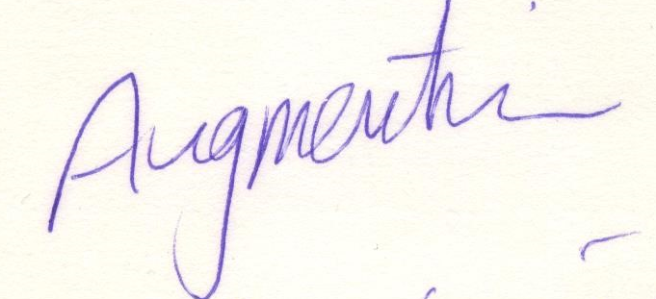
Problem Definition
The traditional way of writing still exist.
Difficulty of medical doctor’s handwriting.
Pharmacists find it difficult to read prescriptions.
Augmentin
Input Image Expected output

Slide 7

Motivation
Despite the abundance of technological writing tools, people still take their notes traditionally: with pen and paper.
In Egypt, patients verbally ask for medications.
Pharmacists find it difficult to read prescriptions.

Slide 8

Agenda
Problem definition & Motivation
Objective
System Architecture
Phases Description
Datasets
Experimental Results
Problem Faced
Conclusion
Demo
Future Work
Tools
Notes:
دي الـ agenda الي هنتكلم عنها في الـ seminar

Slide 9
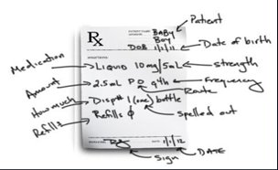
Objective
Implementing the state-of-the-art of HCR relevant to medical prescriptions.
Providing an exact or approximate medication.
Recognized prescription

Slide 10

Agenda
Problem definition & Motivation
Objective
System Architecture
Phases Description
Datasets
Experimental Results
Problem Faced
Conclusion
Demo
Future Work
Tools
Notes:
دي الـ agenda الي هنتكلم عنها في الـ seminar

Slide 11
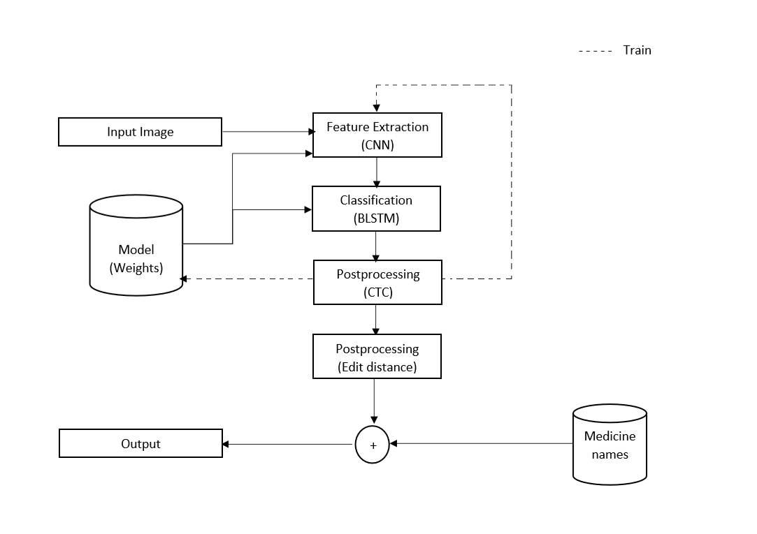
System Architecture
Detailed System Architecture

Slide 12

Agenda
Problem definition & Motivation
Objective
System Architecture
Phases Description
Datasets
Experimental Results
Problem Faced
Conclusion
Demo
Future Work
Tools
Notes:
دي الـ agenda الي هنتكلم عنها في الـ seminar

Slide 13

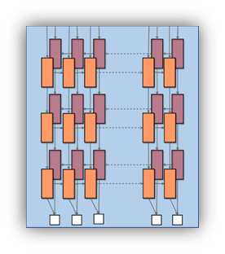
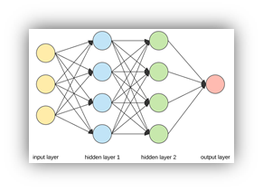


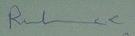
Phases Description
Feature Extraction using CNN.
Classification (BLSTM).
Connectionist Temporal Classification (CTC).
Post-processing.
RELAX
Input
CNN
RNN
CTC
Post-Processing
Exact Medicine
Main phases of our project

Slide 14
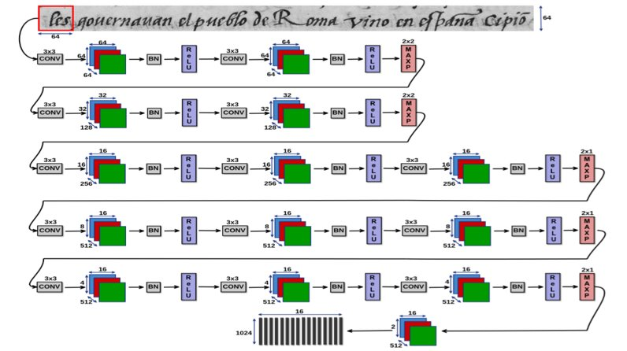
Convolution neural network feature extractor
Input: Text line image.
Window of size 64 × 64.
Layers: 13 Layers contains Convolutional and Maxpooling layers.
Output: Feature vector of size 1024 × 16.
Extracting features using CNN

Slide 15
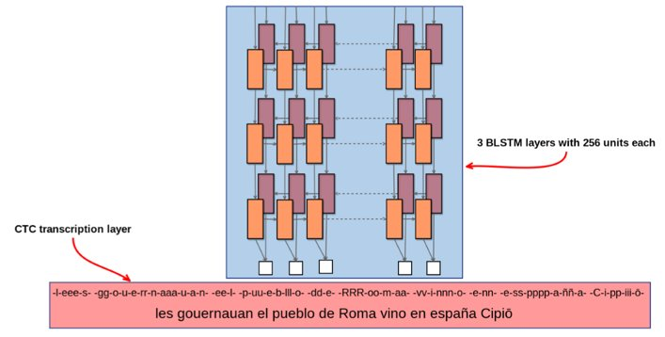
Bidirectional long short-term memory (BLSTM)
Input: Feature Vector.
Layers: 3 BLSTM layers with 256 units per layer.
Output: Recognized characters.
3 Stack bidirectional long short-term memory

Slide 16
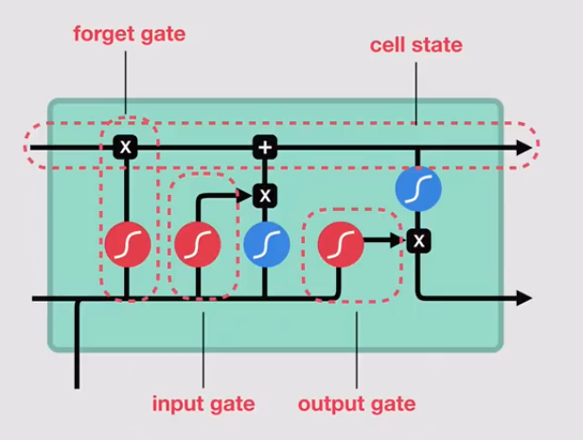
Long short term memory(LSTM)
1- LSTM networks are a type of RNN that uses special units in addition to standard units
2- LSTM units include a 'memory cell' that can maintain information in memory for long periods of time
3- A set of gates is used to control when information enters the memory
4- This architecture lets them learn longer-term
LSTM Gates

Slide 17
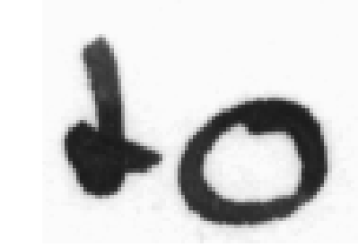


Connectionist Temporal Classification
Input: Sequence of recognized characters.
Output: Recognized text without duplicates.
Input before CTC Output after CTC

Slide 18
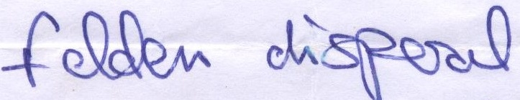
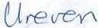
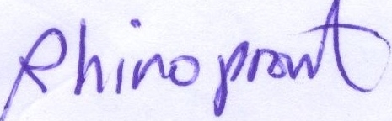
Post-processing
Input : Predicted name and medications database.
Algorithm : Edit Distance.
Output : Closest medications’ names.
Input Image | Prediction output | Post-processing output
 | felden﻿ disperal | FELDENE DISPERAL
 | Ureven | GREEN BREXIN PREVEX URIVIN REVAN
 | Phinopront | RHINOPRO ENZOPROST RHINOCORT CILOPRINE PHINOPRONT PANTOPON INTRON CODIPRONT PHAROFRUIT PHENADONE

Slide 19

Agenda
Problem definition & Motivation
Objective
System Architecture
Phases Description
Datasets
Experimental Results
Problem Faced
Conclusion
Demo
Future Work
Tools
Notes:
دي الـ agenda الي هنتكلم عنها في الـ seminar

Slide 20
Datasets
IAM
The IAM Handwriting Database is structured as follows:
657 writers contributed samples of their handwriting
1'539 pages of scanned text
5'685 isolated and labeled sentences
13'353 isolated and labeled text lines
115'320 isolated and labeled words
Sample of IAM text line.

Slide 21
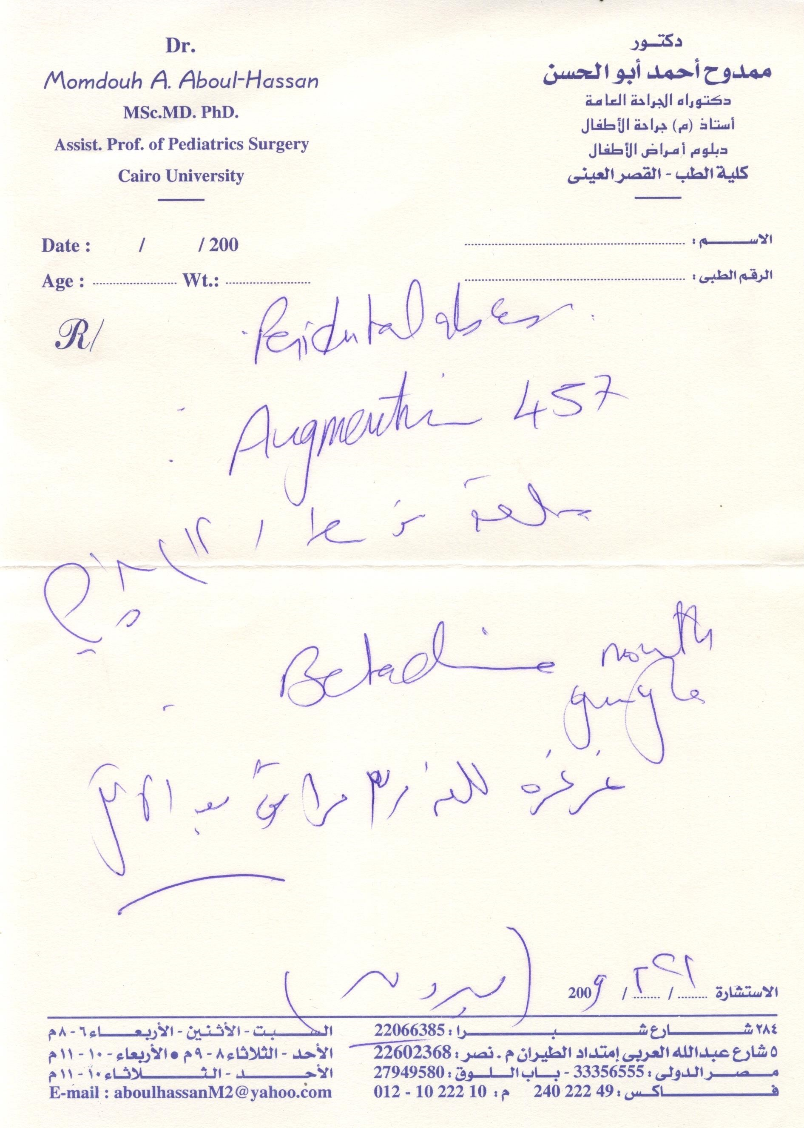
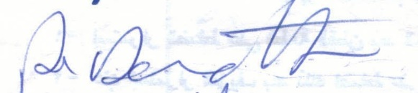
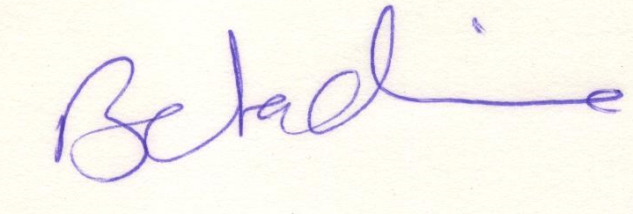
Datasets (Cont.)
​
Medical Forms
We collect around 500 prescription and cropped medicines from prescriptions we obtained around 800 medicine then we label the medicines
Our dataset has degraded levels of hardness i.e.:
Hard:
Easy:
Medium:
Sample of medication
Sample of medication
Sample medical forms
Sample of medication​

Slide 22

Database
We got a large database from (Zidane pharmacy)
This database contains about 8500 medicine.
It was included (Effective substance , Concentration, Medicine name , Cosmetics).
It was used in post-processing phase to extract exact or approximate medicine name.

Slide 23

Agenda
Problem definition & Motivation
Objective
System Architecture
Phases Description
Datasets
Experimental Results
Problem Faced
Conclusion
Demo
Future Work
Tools
Notes:
دي الـ agenda الي هنتكلم عنها في الـ seminar

Slide 24
Experimental Results
Dataset | Training Data | Testing Data | Number of epochs | Learning rate | Batch size | Accuracy | Post-Processing
IAM | 9000 | 4000 | 29 | 0.0005 | 10 | 60% | -
IAM | 9000 | 4000 | 31 | 0.0005 | 10 | 65% | -
Accuracy for all trials on testing IAM dataset only

Slide 25
Experimental Results (Cont.)
Dataset | Training Data | Testing Data | Number of epochs | Learning rate | Batch size | Accuracy | Post-Processing | Rank
IAM | 9000 | 100 (Prescription) | 31 | 0.0005 | 10 | 21% | Yes | 1
IAM + Prescription | 9000 + 700 | 100 (Prescription) | 35 | 0.0005 | 10 | 28% | Yes | 1
IAM | 9000 | 100 (Prescription) | 31 | 0.0005 | 10 | 36% | Yes | 5
IAM + Prescription | 9000 + 700 | 100 (Prescription) | 35 | 0.0005 | 10 | 55% | Yes | 5
IAM | 9000 | 100 (Prescription) | 31 | 0.0005 | 10 | 59% | Yes | 10
IAM + Prescription | 9000 + 700 | 100 (Prescription) | 35 | 0.0005 | 10 | 75% | Yes | 10
Accuracy for all trials on testing Prescriptions

Slide 26

Agenda
Problem definition & Motivation
Objective
System Architecture
Phases Description
Datasets
Experimental Results
Problem Faced
Conclusion
Demo
Future Work
Tools
Notes:
دي الـ agenda الي هنتكلم عنها في الـ seminar

Slide 27
Problems Faced
Unavailability of medical forms dataset (prescriptions)​.
We collected our dataset to feed our model with it.
Difficulty of segmenting cursive handwritten documents.
We cropped medications' names manually out of medical forms.
Annotating prescriptions.
Pharmacists helped with annotating.
Unavailability of medications’ names.
We asked pharmacies for their database.

Slide 28
Problems Faced (Cont.)
Leak of pre-trained models
We had to train our model from scratch.
Ironpython does not work with python 2.7+
Used Tkinter python library for GUI.
Computation power unavailability (Alex bib).
Used Google Colaboratory (Google Colab).
There are no experts to help us with filtering medications.
Leak of segmentation dataset.

Slide 29

Agenda
Problem definition & Motivation
Objective
System Architecture
Phases Description
Datasets
Experimental Results
Problem Faced
Conclusion
Demo
Future Work
Tools
Notes:
دي الـ agenda الي هنتكلم عنها في الـ seminar

Slide 30
Conclusion
We developed Handwriting prescription recognition model which can:
Recognize exact or approximate medicine name from cursive handwriting.
Collected our dataset (prescription forms).
Also, we got helper medications database.
The dataset size:
Training set: 9K image from IAM dataset supported by 700 image from
collected prescription Dataset.
Testing set: 100 prescription image .
Overall obtained accuracy :75%.

Slide 31

Agenda
Problem definition & Motivation
Objective
System Architecture
Phases Description
Datasets
Experimental Results
Problem Faced
Conclusion
Demo
Future Work
Tools
Notes:
دي الـ agenda الي هنتكلم عنها في الـ seminar

Slide 32
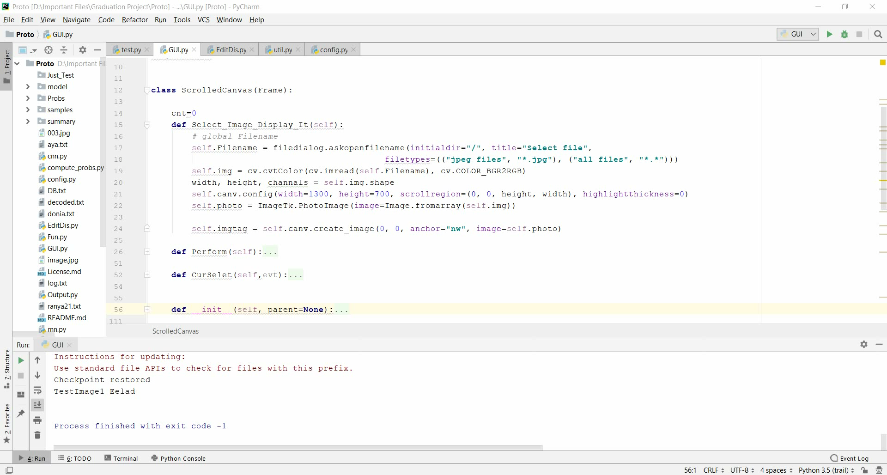

Slide 33

Agenda
Problem definition & Motivation
Objective
System Architecture
Phases Description
Datasets
Experimental Results
Problem Faced
Conclusion
Demo
Future Work
Tools
Notes:
دي الـ agenda الي هنتكلم عنها في الـ seminar

Slide 34
Future Work
It is intended to make automatic segmentation for text lines.
It is intended to expand the project so it can cover many platforms such like: Android, windows, etc.
Categorize database by disease case to reduce search space.
We will improve the performance of the project by using larger prescription dataset.
Use better methods for getting best match of the predicted medication’s name.
Notes:
to support our project with the nearest pharmacy to the patient where the medicine is available

Slide 35

Agenda
Problem definition & Motivation
Objective
System Architecture
Phases Description
Datasets
Experimental Results
Problem Faced
Conclusion
Demo
Future Work
Tools
Notes:
دي الـ agenda الي هنتكلم عنها في الـ seminar

Slide 36




Tools
Python
Anaconda
Numpy
OpenCV
TensorFlow
Colab

Slide 37
References
•[1]Laurence Likforman-Sulem, Edgard Chammas and Chafic Mokbel "Handwriting Recognition of Historical Documents with Few Labeled Data"
•[2] Mohamed Yousef, Khaled F. Hussain, and Usama S. Mohammed "Accurate, Data-Efficient, Unconstrained Text Recognition with Convolutional Neural Networks"
•[3] Rohan Vaidya, Darshan Trivedi, Sagar Satra. "Handwritten Character Recognition Using Deep-Learning." Proceedings of the 2nd International. •[4]Conference on Inventive Communication and Computational Technologies (ICICCT 2018) IEEE Xplore Compliant - Part Number: CFP18BAC-ART; ISBN:978-1-5386-1974-2.
•[5] Pritam Dhande, Reena Kh arat. "Recognition Of Cursive English Handwritten Characters. " International Conference on Trends in Electronics and Informatics ICEI 2017.

Slide 38
References(Cont.)​
•[6] Savitha Attigeri "Neural Network based Handwritten Character Recognition system" Department of Computer Science and Engineering STJIT,Ranebennur 3 March 2018.
•[7] Vishnu Sundaresan, Jasper Lin. “Recognizing Handwritten Digits and Characters” Stanfrod University fall 2015, CS231.
•[8] Gauri Katiyar and Shabana Mehfuz "A hybrid recognition system for off‑line handwritten characters." Department of Electrical Engineering, Jamia Millia Islamia, New Delhi, Indias.

Slide 39
The End
Any questions?

Slide 40
Thank
You

